Slide 1
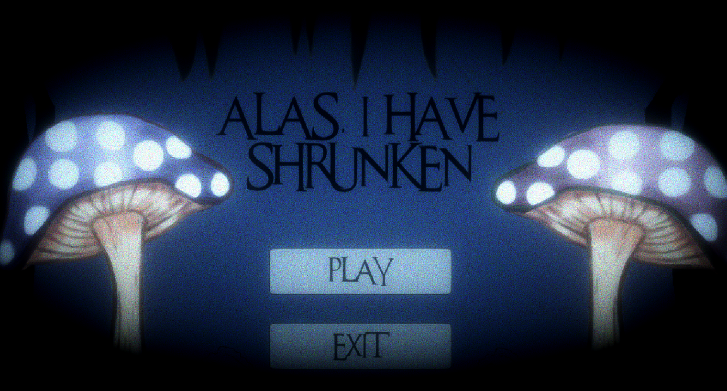
Alas, I have shrunken​
(The Shrooms Studios)​​

Slide 2
TEAM MEMBERS
​
Semra - Producer, Main Artist, Programmer, Designer
Fin - Co-Producer, Main programmer, artist, designer
Don - Sound FX, Music, Post Processing
Dylan - Artist, Designer
​George - Sound FX

Slide 3
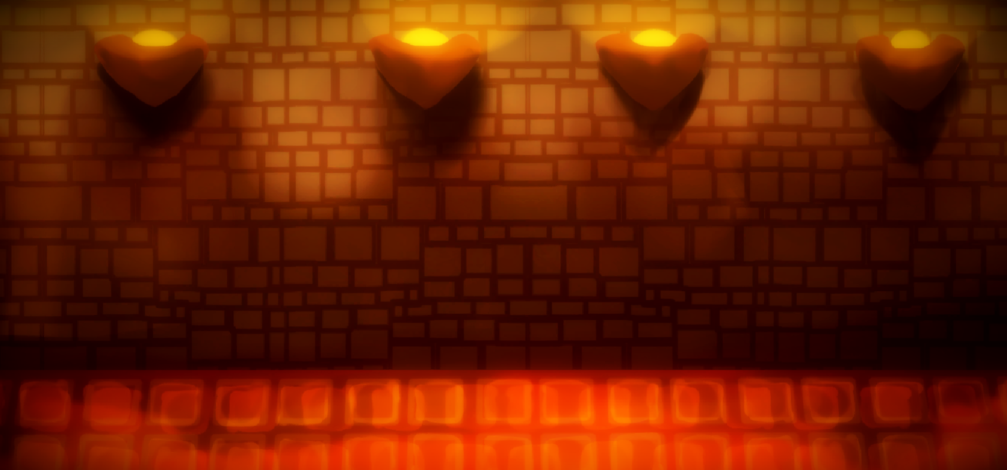
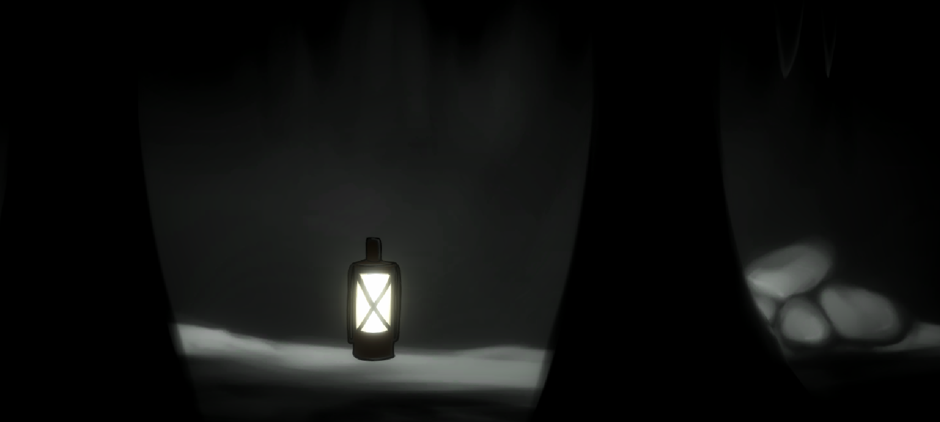
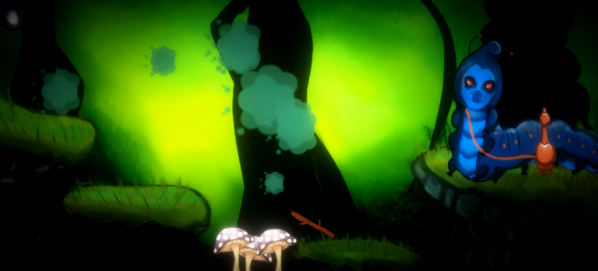
GAME OVERVIEW​
‘Alas, I have shrunken’ is a Dark Fantasy puzzle platformer game loosely based off the story of Alice in Wonderland. ​
​
Available on PC in May 2019​

Slide 4
CONTENT​
Story: ​The game is a loose adaptation of Alice in Wonderland. The Cheshire cat is a puppet master who attempts to slowly turns Alice into his puppet, to stop herself from fully turning into a puppet, she must break the spell by finding magic scissors to cut her puppet strings and escape from wonderland.
Levels: Each level consists of a puzzle which when completed, provides Alice with the magic scissors she needs to cut the strings.

Slide 5
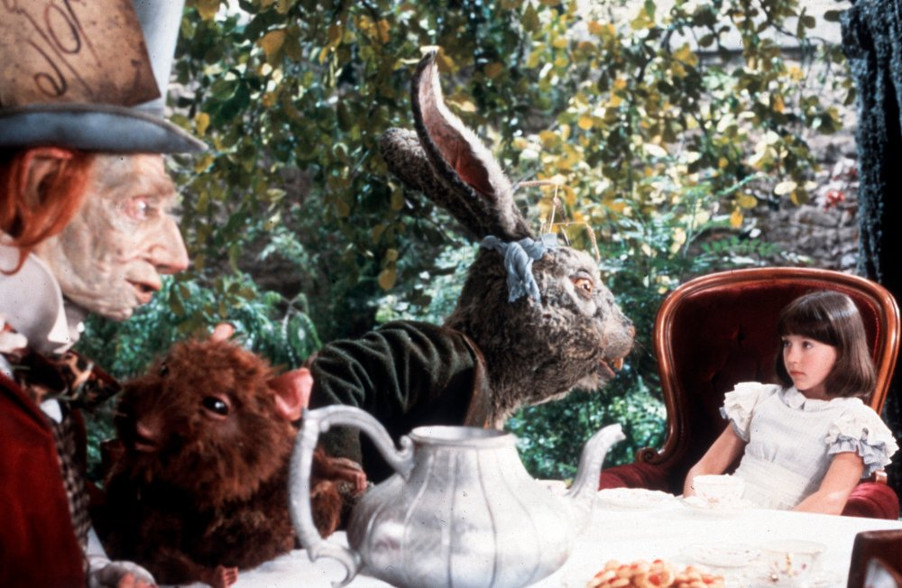
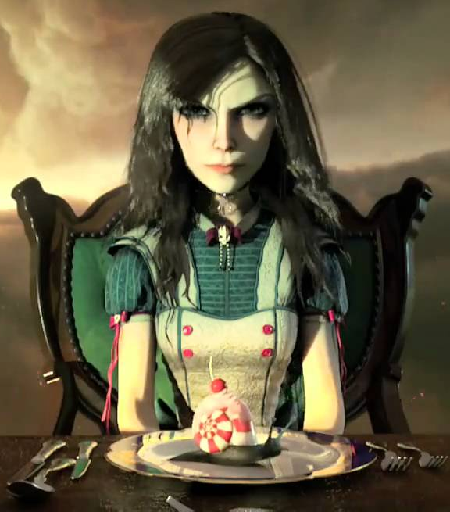
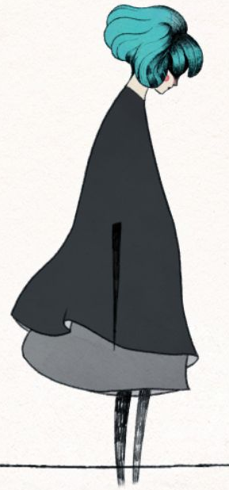
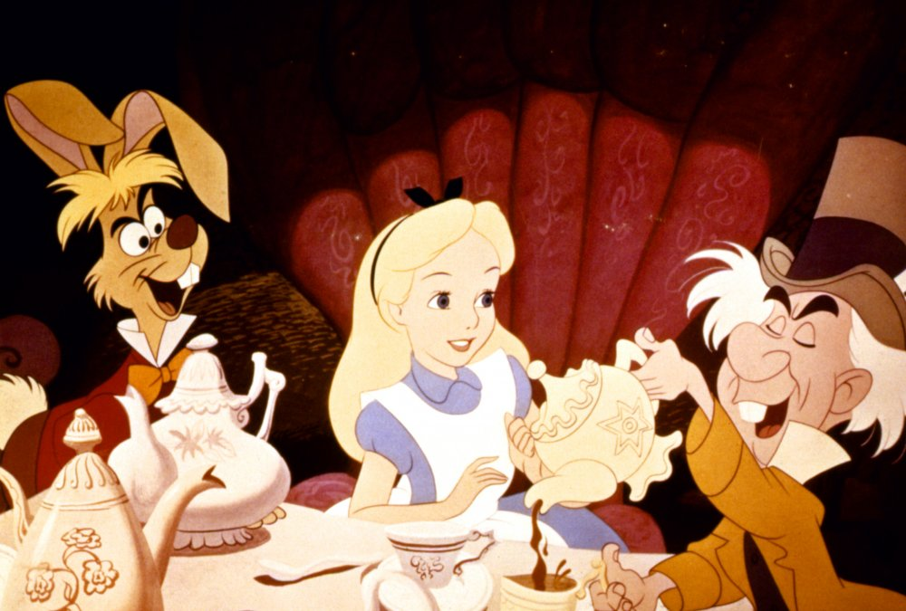
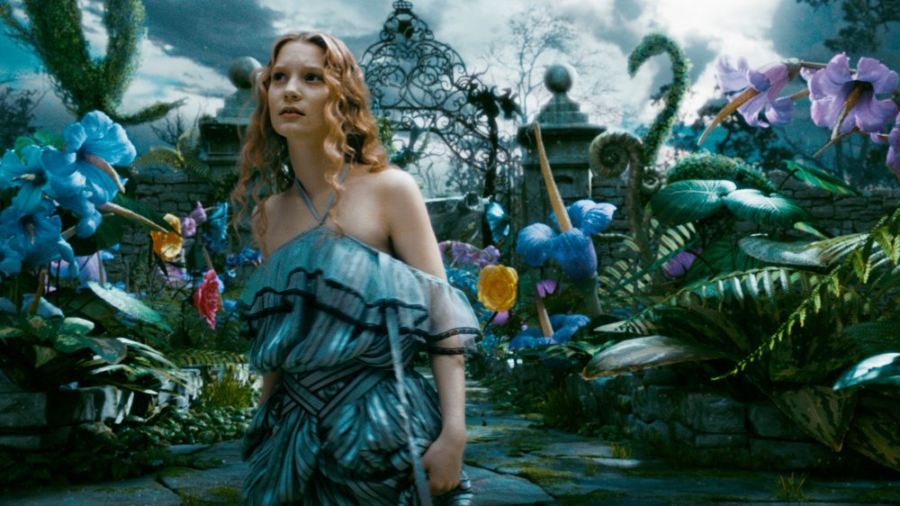
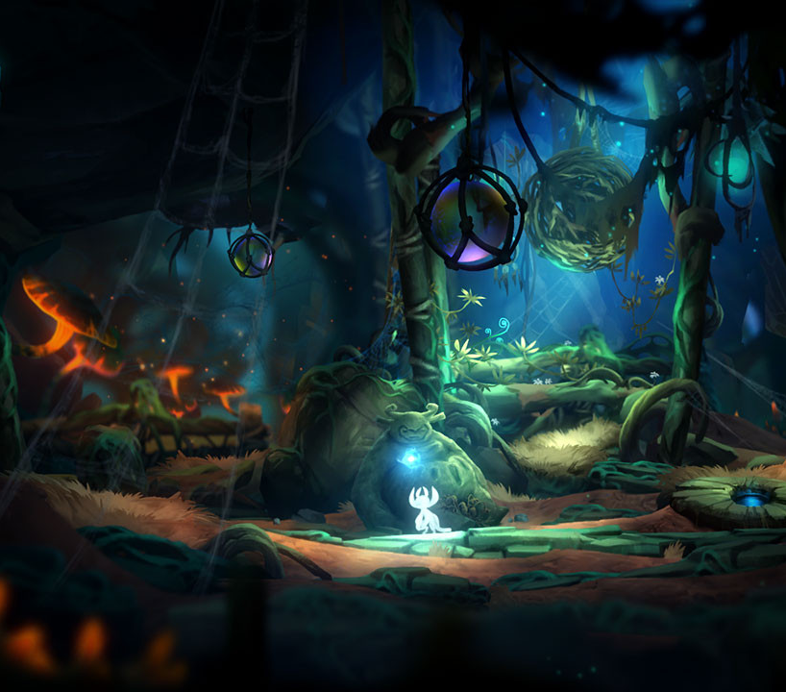
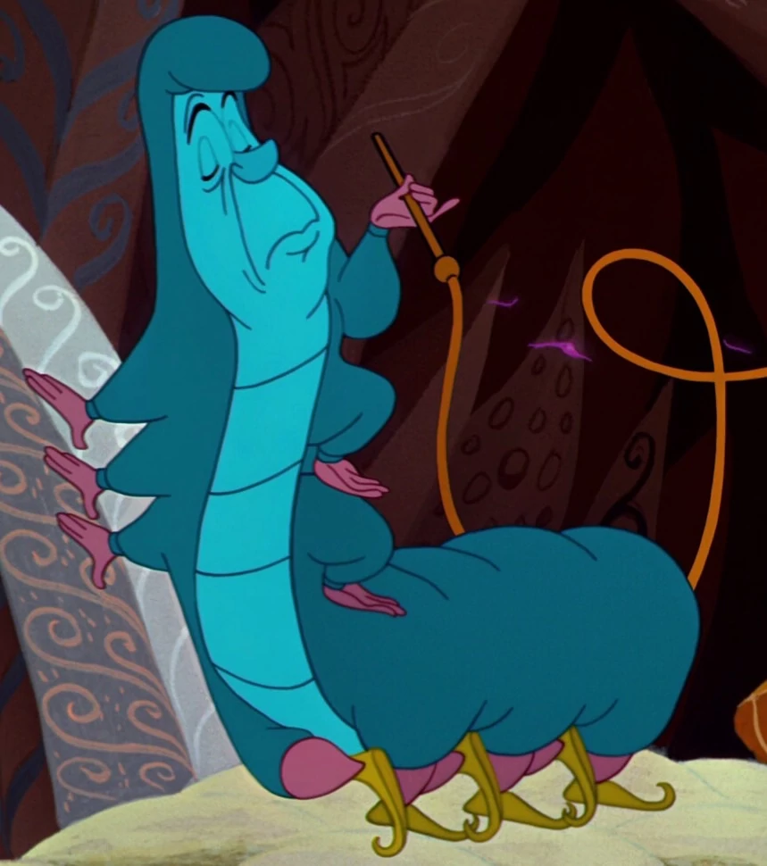
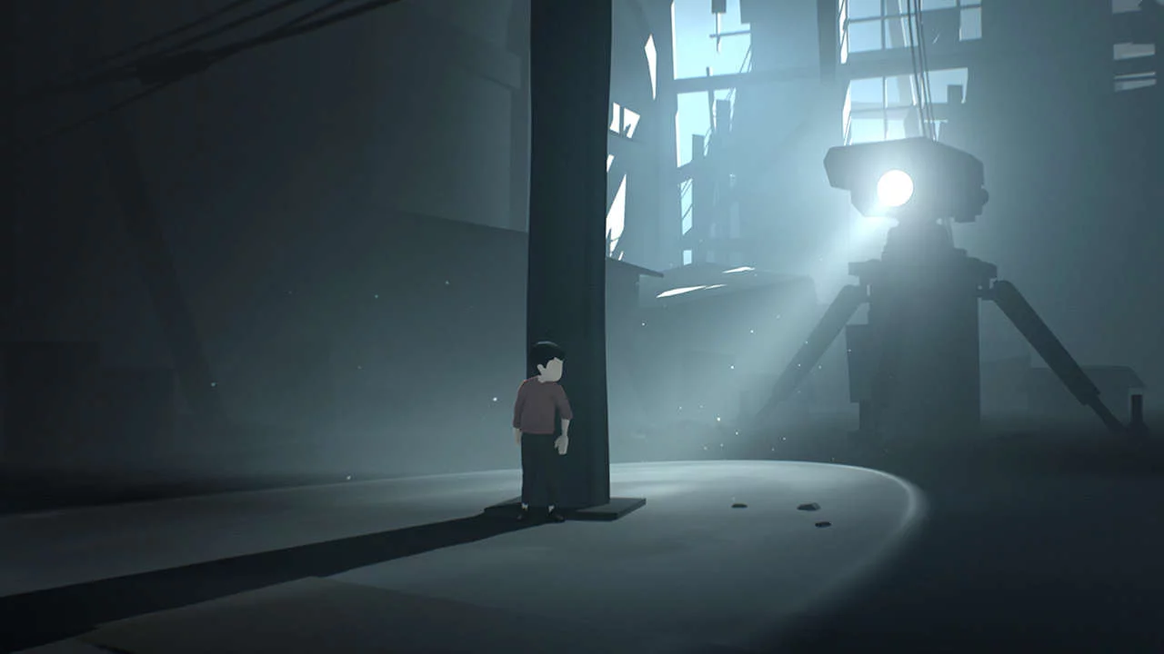
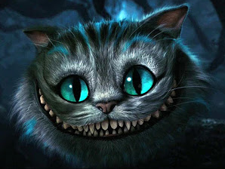
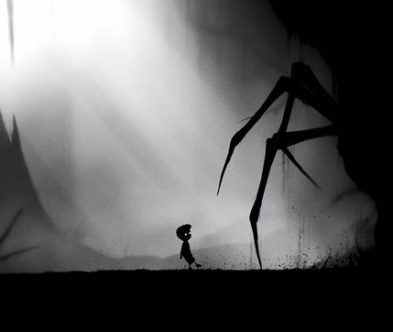
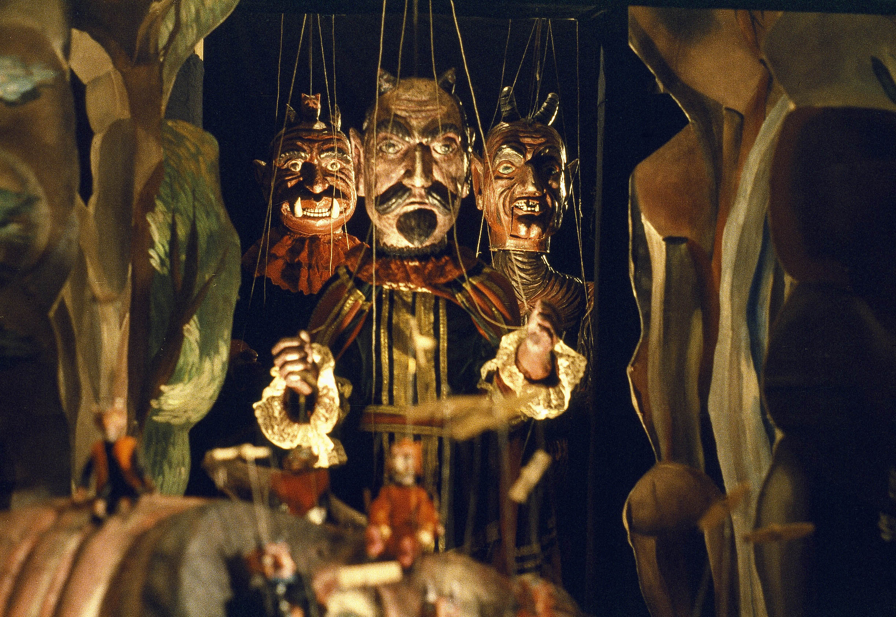

Art Style - Mood Board
[Dreamchild (1985)]
[Alice in Wonderland (1951)]
[Alice Madness Returns (2011)]
[Gris (2018)]
[Alice in Wonderland (2010) Dir. by Tim Burton]
[Ori and The Blind Forest (2015)]
[Inside (2016)]
[Limbo (2010)]
[Thomas Was Alone (2012)]
[Faust (1994) Dir. by Jan Švankmajer]

Slide 6
Music and Sound FX Inspiration
Faust 1994 - Tone
Alice 1988 Svankmajer - Creepiness
Alice In Wonderland 1999 - Main Theme use of Violins
Some FX were inspired by video games, e.g “shrink” sound inspired by Mario series.

Slide 7
COMPETITIVE ANALYSIS​
What else is in the market?​
Limbo, Inside, Thomas was alone, Gris, Ori and the blind forest
Why are we different?​
Simplistic Style and requires some thinking to complete puzzles
Why are we better?​
Because our game is an original adaptation that takes different aspects from several games as well as movies in its storyline and gameplay.

Slide 8
PRODUCTION SCHEDULE​
If we had more time:​
Polish Code (1 - 3 weeks)
Addition of dialogue (2-3 weeks)
More Art (2 - 3 weeks)
More Levels (4 - 6 weeks)
More Enemies (3 - 5 weeks)

Slide 9
Thank you for listening!

